Slide 1
11/7/22

Slide 2
5.2 & 5.3
Constructors, Comments, and Conditions

Slide 3
Recap
Back in Unit 2, we learned how to create objects using a constructor:
// To create a new object, write: // ClassName variableName = new ClassName(arguments); World world = new World(); Turtle t = new Turtle(world); Person p = new Person("Pat","pat@gmail.com","123-456-7890");
Now, we're going to learn how to define Constructors

Slide 4
The Anatomy of a Constructor
Things to keep in mind:
The Constructor name (in red) must always match the name of the class (in blue)
Always prepend the public keyword before your constructor name
Constructors have no return type. Not even void!
The constructor definition is often included before other method definitions (but is not required)
public class ClassName { // Instance Variable Declarations // Constructor - same name as Class, no return type public ClassName() { // Implementation not shown } // Other methods ... }

Slide 5
Instance Variable Initialization
Instance Variables are properties of your class (name, age, and isAlive in this example)
They are normally given initial values within your Constructor
They can also be defined in place (i.e. private boolean isAlive = true;)
public class Person { private String name; private int age;
private boolean isAlive = true;
public Person(String initName, int initAge) { name = initName; age = initAge; } }

Slide 6
Types of Constructors
Default Constructor
No-Argument Constructor
Parameterized Constructor
Overloaded Constructors
Automatically generated by the Java compiler when you do not supply a Constructor
Does not do any kind of specialized initialization of the Instance beyond whatever inplace variable initialization that exists
Instance variables without inplace initialization will default to something "reasonable"
int -> 0
boolean -> false
String -> null
Object -> null

Slide 7
Default Constructor
public class Person { public String name;
public int age = 15;
// No constructor defined
// Java creates Default Constructor
}
Person person = new Person(); System.out.println(person.name); > null System.out.println(person.age); > 15

Slide 8
Types of Constructors
Default Constructor
No-Argument Constructor
Parameterized Constructor
Overloaded Constructors
A Constructor you define that takes no arguments
Can perform any kind of initialization that the the Instance requires
Every Instance is initialized exactly the same
No values can be passed in during new to customize the Instance

Slide 9
No-Argument Constructor
public class Person
{
public String name;
public int age = 15;
public Person() {
name = "Billy";
age = 25;
}
}
Person person = new Person(); System.out.println(person.name); > Billy System.out.println(person.age); > 25

Slide 10
No-Argument Constructor
public class Person
{
public String name;
public int age = 15;
public Person() {
name = "Billy";
age = 25;
}
}
Person person = new Person(); System.out.println(person.name); > Billy System.out.println(person.age); > 25
When you define a Constructor (any kind) Java will NOT create a Default Constructor!

Slide 11
Types of Constructors
Default Constructor
No-Argument Constructor
Parameterized Constructor
Overloaded Constructors
A Constructor you define that takes arguments
Can perform any kind of initialization that the the Instance requires
Each Instance is initialized individually based on the values passed into new

Slide 12
Parameterized Constructor
public class Person
{
public String name;
public int age = 15;
public Person(String initName) {
name = initName;
}
}
Person person = new Person("Julie"); System.out.println(person.name); > Julie System.out.println(person.age); > 15

Slide 13
Parameterized Constructor
public class Person
{
public String name;
public int age = 15;
public Person(String initName) {
name = initName;
}
}
Person person = new Person("Julie"); System.out.println(person.name); > Julie System.out.println(person.age); > 15
Person otherPerson = new Person();
Question: What happens here? And why?

Slide 14
Parameterized Constructor
public class Person
{
public String name;
public int age = 15;
public Person(String initName) {
name = initName;
}
}
Person person = new Person("Julie"); System.out.println(person.name); > Julie System.out.println(person.age); > 15
Person otherPerson = new Person(); ** ERROR **
Question: What happens here? And why?
When you define a Constructor (any kind) Java will NOT create a Default Constructor!

Slide 15
Types of Constructors
Default Constructor
No-Argument Constructor
Parameterized Constructor
Overloaded Constructors
A Class may have multiple Constructors
Each Constructor must be named the same as the Class; have no return type; and have a distinct set of parameters (types)
These are useful when you want to provide default values for some Instance variables - While allowing other Instance variables to be set via new

Slide 16
Overloaded Constructors
Person person1 = new Person(); System.out.println(person1.name); A> System.out.println(person1.age); B>
Person person2 = new Person("Julie"); System.out.println(person2.name); C> System.out.println(person2.age); D>
Person person3 = new Person("Julie", 25); System.out.println(person3.name); E> System.out.println(person3.age); F>
public class Person
{
public String name;
public int age = 15;
public Person() {
name = "Name unknown"; }
public Person(String initName) {
name = initName;
age = 30;
}
public Person(String initName, int initAge) {
name = initName;
age = initAge;
}
}

Slide 17
Overloaded Constructors
Person person1 = new Person(); System.out.println(person1.name); A> Name unknown System.out.println(person1.age); B> 15
Person person2 = new Person("Julie"); System.out.println(person2.name); C> System.out.println(person2.age); D>
Person person3 = new Person("Julie", 25); System.out.println(person3.name); E> System.out.println(person3.age); F>
public class Person
{
public String name;
public int age = 15;
public Person() {
name = "Name unknown"; }
public Person(String initName) {
name = initName;
age = 30;
}
public Person(String initName, int initAge) {
name = initName;
age = initAge;
}
}

Slide 18
Overloaded Constructors
Person person1 = new Person(); System.out.println(person1.name); A> Name unknown System.out.println(person1.age); B> 15
Person person2 = new Person("Julie"); System.out.println(person2.name); C> Julie System.out.println(person2.age); D> 30
Person person3 = new Person("Julie", 25); System.out.println(person3.name); E> System.out.println(person3.age); F>
public class Person
{
public String name;
public int age = 15;
public Person() {
name = "Name unknown"; }
public Person(String initName) {
name = initName;
age = 30;
}
public Person(String initName, int initAge) {
name = initName;
age = initAge;
}
}

Slide 19
Overloaded Constructors
Person person1 = new Person(); System.out.println(person1.name); A> Name unknown System.out.println(person1.age); B> 15
Person person2 = new Person("Julie"); System.out.println(person2.name); C> Julie System.out.println(person2.age); D> 30
Person person3 = new Person("Julie", 25); System.out.println(person3.name); E> Julie System.out.println(person3.age); F> 25
public class Person
{
public String name;
public int age = 15;
public Person() {
name = "Name unknown"; }
public Person(String initName) {
name = initName;
age = 30;
}
public Person(String initName, int initAge) {
name = initName;
age = initAge;
}
}

Slide 20


Slide 21
Comments
Comments are a way for you to annotate your code
This is text in your program that is never run by Java and is added for the benefit of the person reading the code
You can also "comment out" a block of code during development to assist in the development or debugging process
There are 3 ways to write comments in Java

Slide 22
Types of Comments
Single-Line Comment
Multi-Line Comment
Documentation Comment
A single-line comment starts with a double forward-slash (//)
Can start anywhere - i.e. does not need to be in column 0
All characters following the double forward-slash are ignored until newline or end of file thisCodeWillRun(); // thisCodeWillNotRun(); thisCodeWillRun(); thisCodeWillRun(); // woo-hoo!

Slide 23
Types of Comments
A multi-line comment starts with a forward-slash asterisk (/*)
Can begin anywhere - i.e. does not need to be in column 0
All characters - including newlines - are considered part of the comment until a asterisk forward-slash (*/) is encountered
Your editor may have a key command that automatically converts a block of code into a multi-line comment /* thisCodeWillNotRun(); thisCodeWillNotRun(); */
/* thisCodeWillNotRun(); */ thisCodeWillRun(); /* woo-hoo! */
Single-Line Comment
Multi-Line Comment
Documentation Comment

Slide 24



Start Multi-Line Comment
Roll your fingers from the left to the right
End Multi-Line Comment
Roll your fingers from the right to the left

Slide 25
Types of Comments
A variant of the multi-line comment syntax - Documentation Comments start with a forward-slash asterisk asterisk (/**)
Typically found just prior to the definition of a function or method
All characters - including newlines - are considered part of the Documentation Comment until a asterisk forward-slash (*/) is encountered
Within a Documentation Comment - other standard components may be supported /** * Documentation comment * */ myMethod()
Single-Line Comment
Multi-Line Comment
Documentation Comment

Slide 26
Preconditions and Postconditions
DEFINITELY on AP exam

Slide 27
Preconditions and Postconditions
Preconditions and postconditions are a "contract" that describes what a method requires about its inputs, and what it promises as output.
Precondition
Postcondition
index must be >= 0
and < length of string
public char charAt(int index);
character at index index will be returned
The caller must satisfy this requirement when calling charAt.
In return, the desired character will be returned.

Slide 28
Preconditions
Preconditions are part of the method's documentation, and may exist only as comments.
There is no expectation that the method will check to ensure preconditions are satisfied.
They may or may not be enforced by the method's code – the programmer using the method should read the documentation and understand the "contract" the method offers.
/**
* Precondition: num2 is not zero.
* Postcondition: Returns the quotient of num1 and num2.
*/
public double divide(double num1, double num2)
{
return num1 / num2;
}

Slide 29
Who enforces preconditions?
Sometimes preconditions ARE enforced by the method's code.
An actual implementation of Java's String.charAt:
Here, an exception is thrown if the precondition is not satisfied.
Throwing an exception in Java is a common way to handle failed preconditions.
public char charAt(int index) { if ((index < 0) || (index >= value.length)) { throw new StringIndexOutOfBoundsException(index); } return value[index]; }

Slide 30
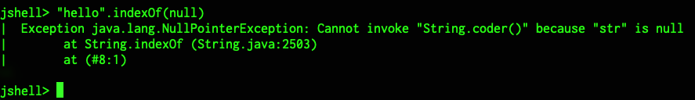
Who enforces preconditions?
Sometimes preconditions are enforced by some other mechanism.
str.indexOf(null) doesn't work, so String.indexOf(String str) has a precondition that str is not null.
The programmer of indexOf decided it was OK to let Java throw a NullPointerException to "enforce" the precondition.
Depending on the situation, it may or may not make sense to enforce preconditions in code... but they definitely should be documented.

Slide 31
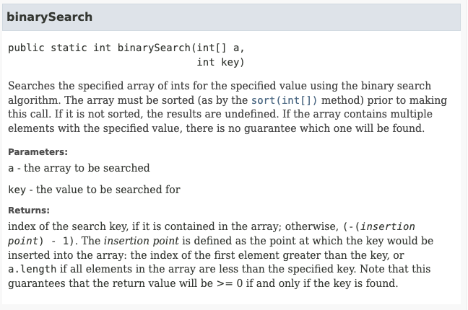
Who enforces preconditions?
At other times, it is not reasonable for the method to enforce the precondition.
The programmer calling the method must understand the preconditions and satisfy them.
The precondition here exists only as documentation, and describes the consequences of failing to meet it. (Where is the precondition?)

Slide 32
Postconditions
A postcondition is a condition that is true after running the method. It is what the method promises to do.
Postconditions describe the outcome of running the method, for example what is being returned or the changes to the instance variables.
Examples:
String.compareTo() The method returns 0 if the string is equal to the other string. A value less than 0 is returned if the string is less than the other string (less characters) and a value greater than 0 if the string is greater than the other string (more characters).
Math.random Returns a double value with a positive sign, greater than or equal to 0.0 and less than 1.0.

Slide 33
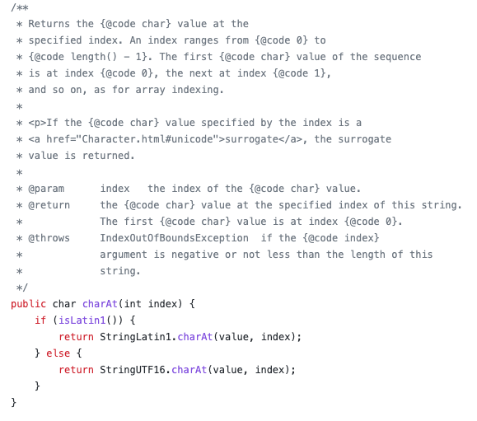
Javadoc
Documentation for Java code is often written as documentation comments, and then HTML is generated with a tool called javadoc.
Code and documentation used to be written separately... the idea of doc comments is that if the doc is with the code, it's less likely to be stale.
The javadoc often describe a method's preconditions and postconditions.

Slide 34
Practice on your own
CSAwesome 5.2 Writing Constructors
CSAwesome 5.3 Comments and Conditions
ConditionWorld Exercise in Replit

